Slide 1
Chapter 08 Java Interfaces
FALL 2021

Slide 2
Creating and using Interfaces
Interfaces
Declared with the keyword interface
Contains only constants and abstract methods
All fields are implicitly public static final
All methods are implicitly public abstract
Classes implement interfaces
The class must declare each method in the interface using the same signature or the class must be declared abstract
Typically used when disparate classes need to share common methods and constants
Normally declared in their own files with the same names as the interfaces and with the .java file-name extension.

Slide 3
Common Programming Error
Failing to implement any method of an interface in a concrete class that implements the interface results in a compilation error indicating that the class must be declared abstract.
Attempting to instantiate an interface is a compilation error.

Slide 4
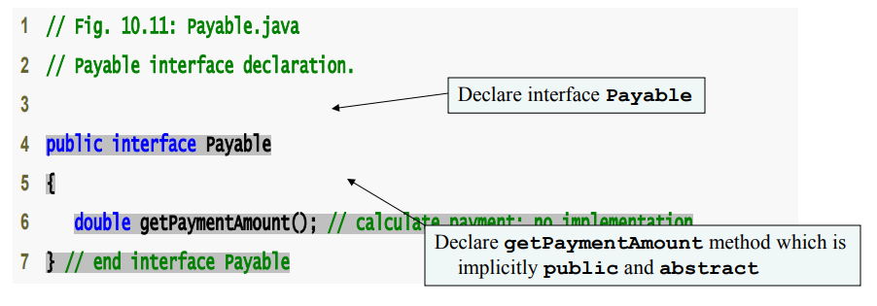
Developing a Payable Hierarchy
Payable interface
Contains method getPaymentAmount()
Is implemented by the Invoice and Employee classes

Slide 5
Creating Class Invoice
A class can implement as many interfaces as it needs
Use a comma-separated list of interface names after keyword implements
Example: public class ClassName extends SuperclassName implements FirstInterface, SecondInterface, …

Slide 6
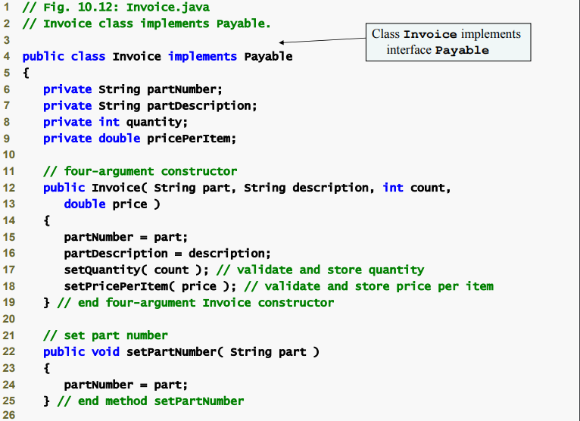

Slide 7
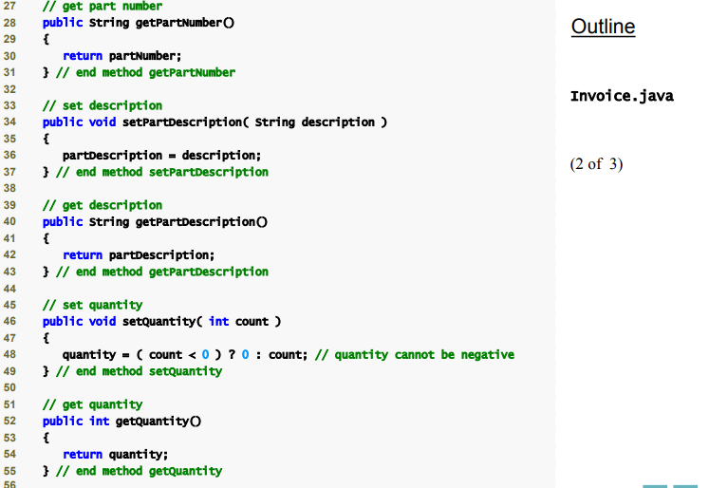

Slide 8
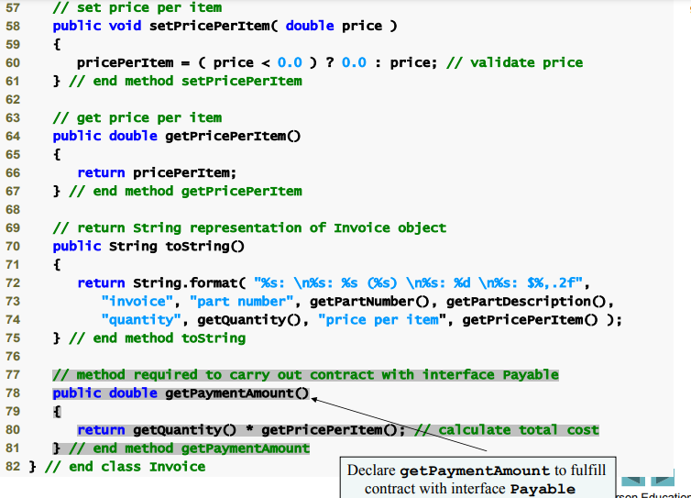

Slide 9
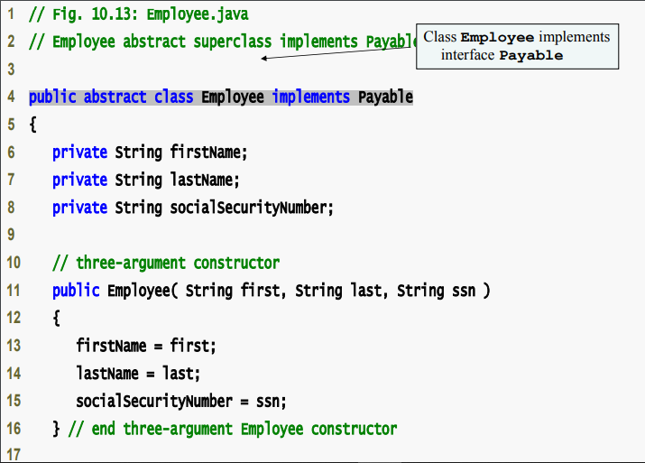

Slide 10
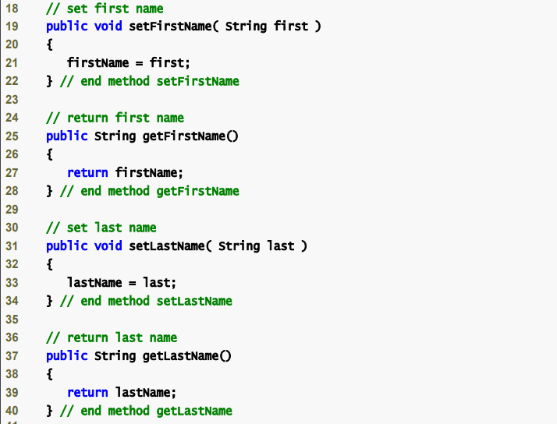

Slide 11
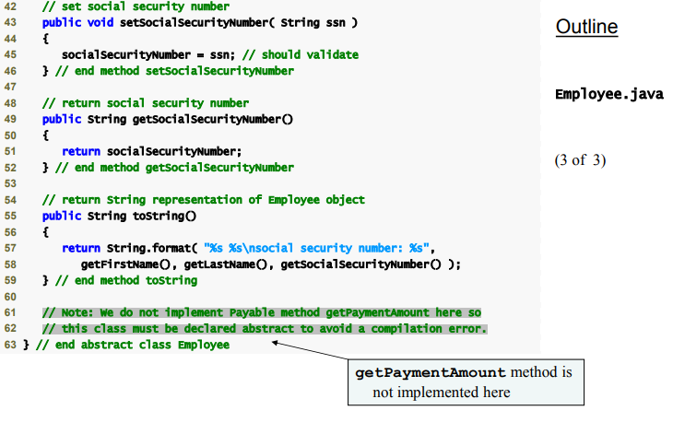

Slide 12
Modifying Class SalariedEmployee for Use in the Payable Hierarchy
Objects of any subclasses of the class that implements the interface can also be thought of an objects of the interface.
A reference to a subclass object can be assigned to an interface variable if the superclass implements that interface.

Slide 13
Inheritance and interfaces are similar in their implementation of the “is-a” relationship. An object of a class that implements an interface may be thought of as an object of that interface type. An object of any subclasses of a class that implements an interface also can be thought of as an object of the interface type.

Slide 14
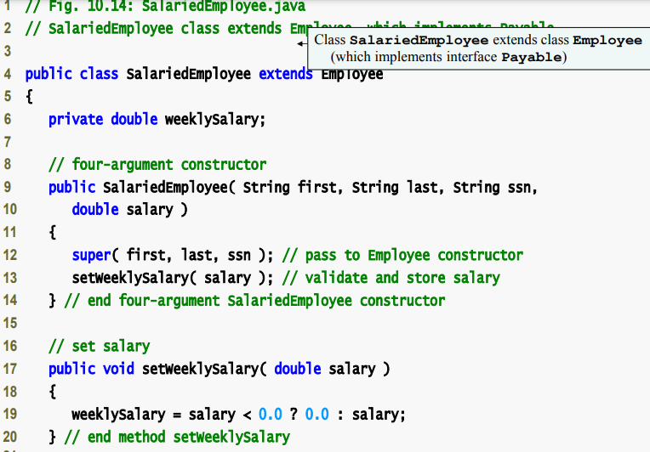

Slide 15
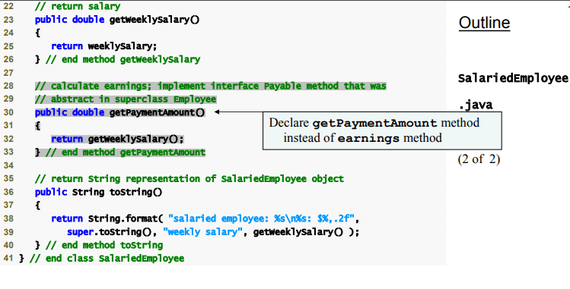

Slide 16
The “is-a” relationship that exists between superclasses and subclasses, and between interfaces and the classes that implement them, holds when passing an object to a method. When a method parameter receives a variable of a superclass or interface type, the method processes the object received as an argument polymorphically.

Slide 17
Using a superclass reference, we can polymorphically invoke any method specified in the superclass declaration (and in class Object). Using an interface reference, we can polymorphically invoke any method specified in the interface declaration (and in class Object).

Slide 18
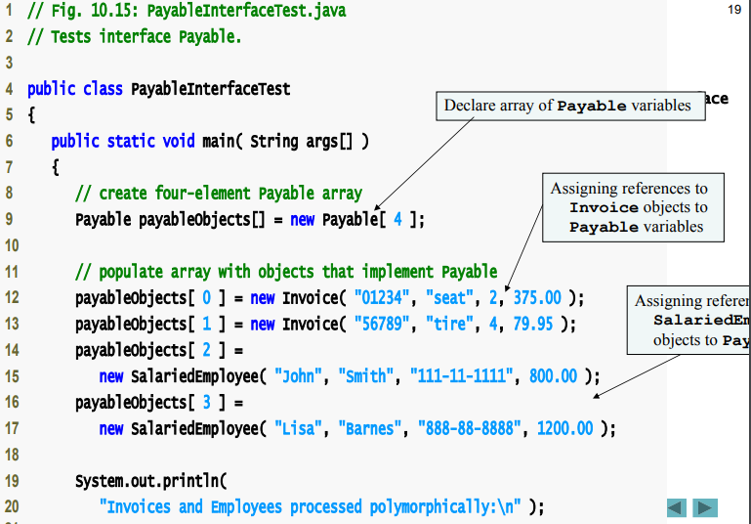

Slide 19
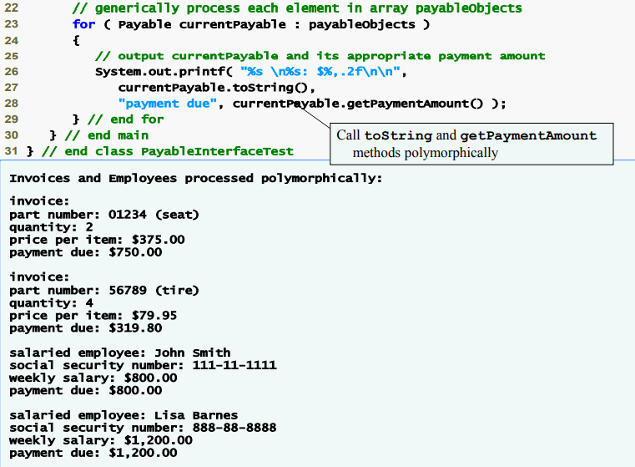

Slide 20
Declaring Constants with Interfaces
Interfaces can be used to declare constants used in many class declarations
These constants are implicitly public, static, and final
Using a static import declaration allows clients to use these constants with just their names.

Slide 21
Static import
Static import declarations
Enables programmers to refer to imported static members as if they were declared in the class that uses them.
Single static import
Import static packageName.ClassName.staticMemberName;
Static import on demand
Import static packageName.ClassName.*;
Imports all static members of the specified class

Slide 22
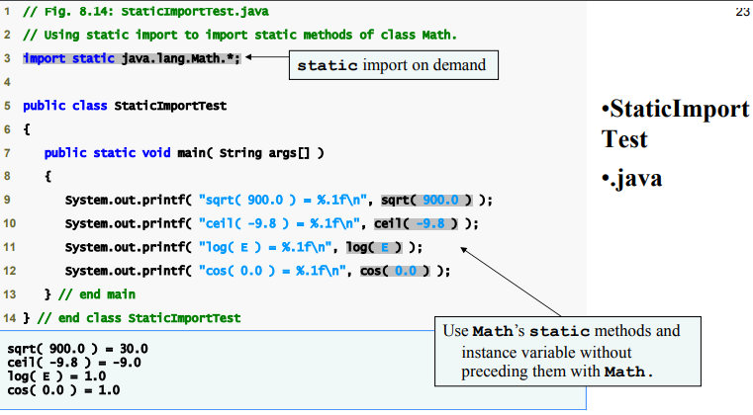

Slide 23
A compilation error occurs if a program attempts to import static methods that have the same signature or static fields that have the same name from two or more classes.

